Slide 1

PRESENTED BY NUR SYAFINATULZANIS BINTI ISHAK
E-COURSE APP

Slide 2

INTRODUCTION
in the digital era, most of the people already depends on internet. The student also depends on internet in further their study. All the student must have the app to make them easier to know about their course in the university. Because of that I create this ap which is e-course app to make their life more easier. They can do many thing in this app like view their exam, add course, view exam result and many more.

Slide 3
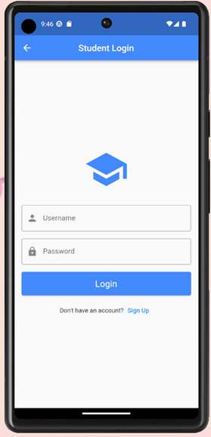
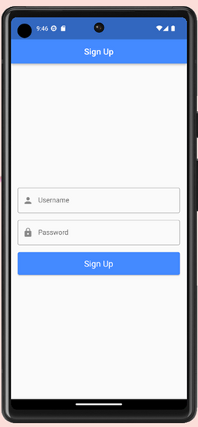
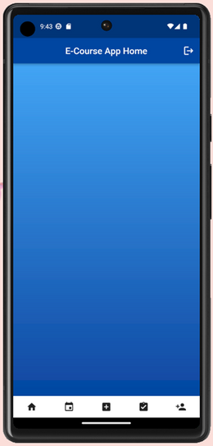
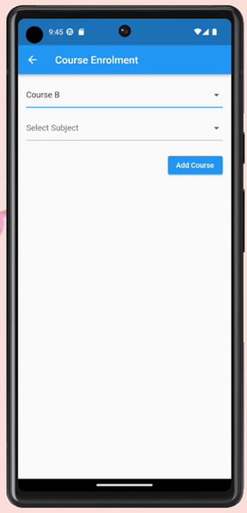
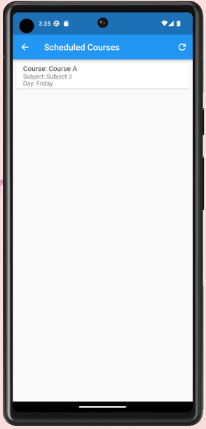
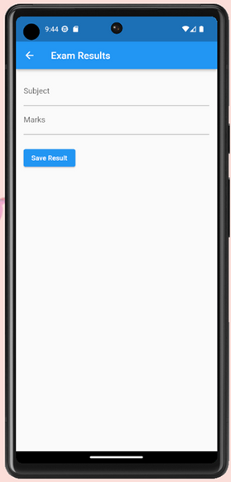
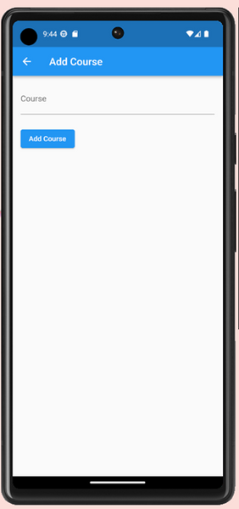
INTERFACE

Slide 4
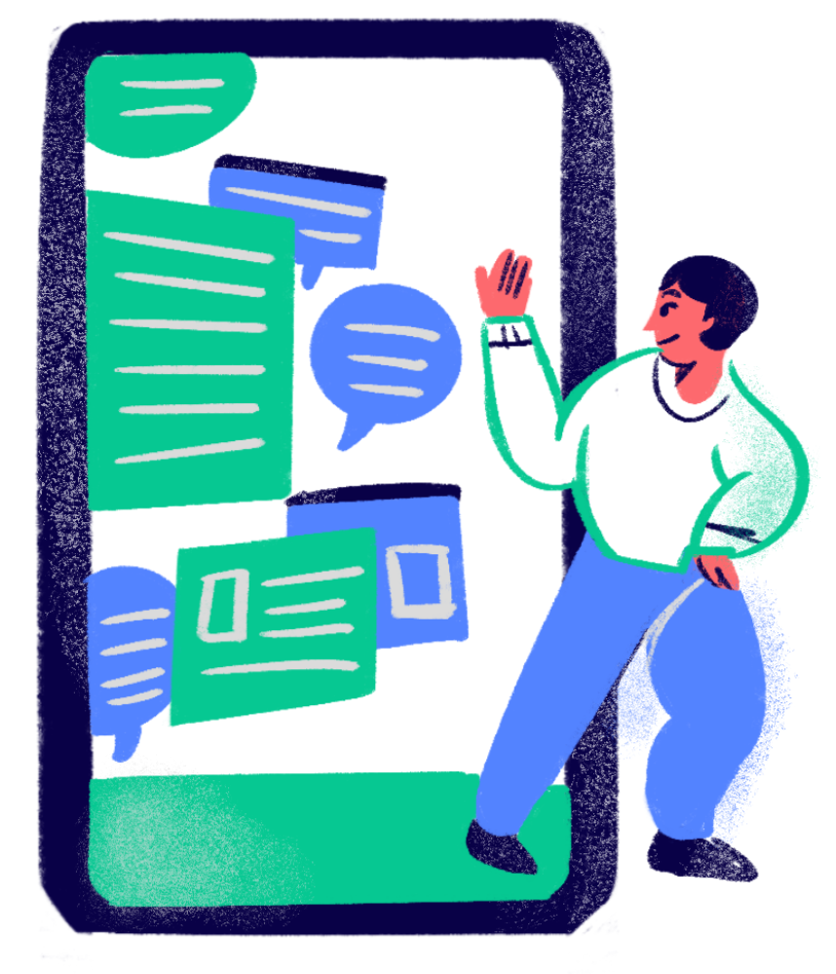
CONCLUSION
In conclusion, this app make the student’s life more easier because they can use this app while further their study. This app also help them to know about their course, class schedule, their exam and can enroll course. So I hope while using this app their life and work will become more easier and more better.

Slide 5
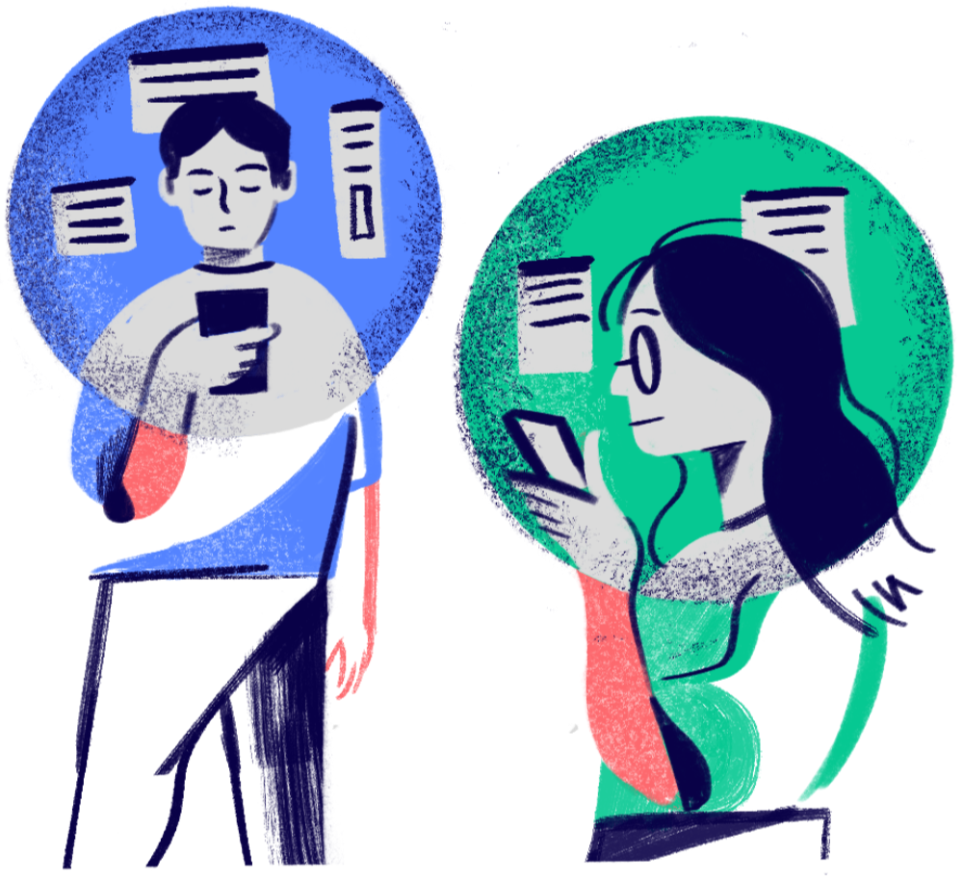
THANK YOU VERY MUCH!

